Slide 1

Education Connection Express: Unleashing Tennessee's Academic Potential
A Journey Through Data, Discovery, and Empowerment
Patrick Johnston
8/18/2023
Notes:
Welcome aboard the 'Education Connection Express'! Just like the roller coasters at Dollywood, the journey towards a college degree is filled with ups and downs. But together, we can turn education from a privilege into a right.

Slide 2
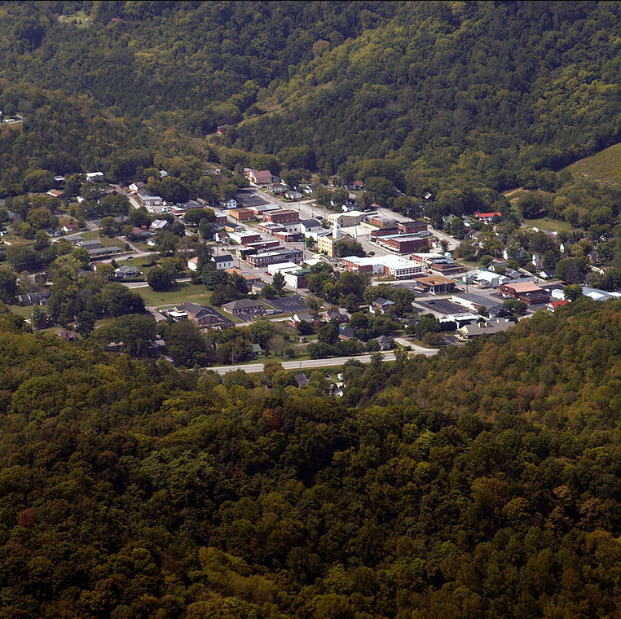
Motivation
Personal connections of rural communities, attending the only high school in the county, and experiencing all the uneven resources turned this into a passion project for me. Relatability and empathy starts with conversations.
Notes:
Imagine growing up in a small rural county, where everyone knows your name, and attending the lone high school. Their sports, and the weekly mugshots in the paper of the people who got left behind, are the heart of the town. That's my story, and it's filled with the harsh realities of uneven resources. When you’re at that age, you don’t really seem to realize it until someone else points out your transgressions you once called charm, or even grit. But rather than just a memory, lately it's become the fuel for my passion project. Especially after being given the tools through NSS that are required to visually spark conversations through relatability and empathy.

Slide 3

All Aboard the Learning Express: Next Stop, Discovery!
Get ready for an Exciting Expedition Through Tennessee’s Educational Landscape
Hop aboard the Education Connection Express, where the thrilling ride through Tennessee's academic wonderland awaits! Disclaimer: While I can't promise literal seat-jumping excitement for passengers already onboard this adventure, I do guarantee a journey full of meaningful discovery and insight. With the mighty quartet of Python, Excel, Power BI and Tableau at my disposal, let's make a positive impact on our youth and unleash the potential of our future leaders. So, fasten your seat belt and get ready for a detailed and fun, yet enlightening experience!
Notes:
My capstone project is all about leveling the playing field. It's about giving every kid, regardless of their background, a ticket to ride. So, choo choo! Let's embark on a journey for change, where we'll explore the relationship between counties in TN, their bachelor degree attainment rates, financial , and how we can close the educational gap.

Slide 4

The Education Connection Express: MVP Overview
Through exploration of possible key factors influencing college-going and educational attainment rates in different Tennessee counties, the MVP will leverage numerous governmental datasets by way of Excel, Python, and Tableau/Power BI for data exploration, analysis, visuals, and reporting discovered information.

Slide 5
First Stop: The Curious Junction of Data Questions
1) What are the key factors influencing college-going rates and educational attainment in different Tennessee counties?
2) How do these factors shape undergraduate degree completion?
3) How do they shape financial aid accessibility?

Slide 6
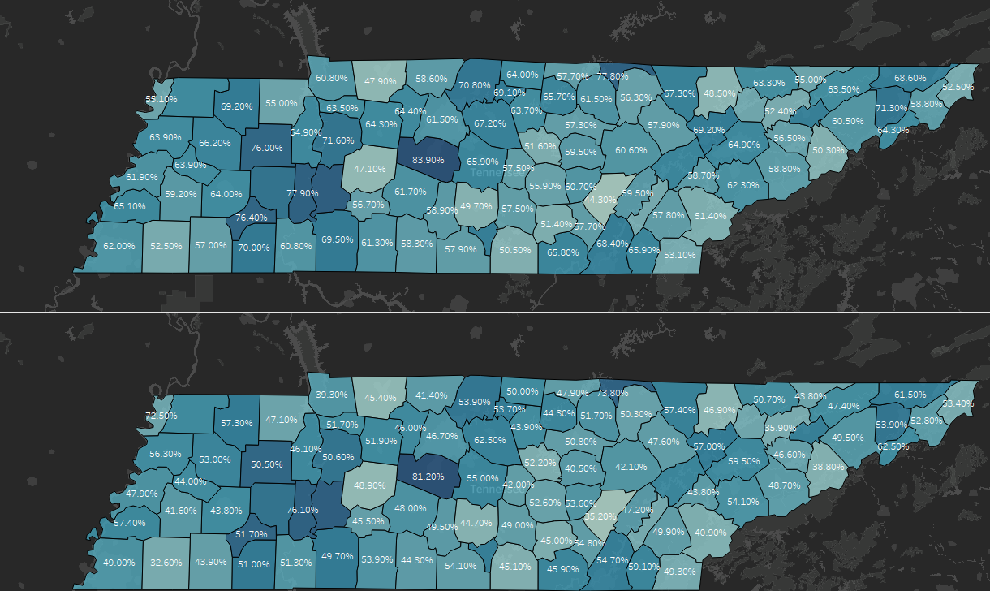
Counties and their College-Going Rate
2016
College Going Rate
Heatmap
2021
Notes:
College going rates. Counties such as Jackson, Fayette, Shelby, and Stewart county all had noticeable drops in college going attendance, but counties like Williamson and Perry managed to remain somewhat similar. Could this be a covid or financial factor or both?

Slide 7
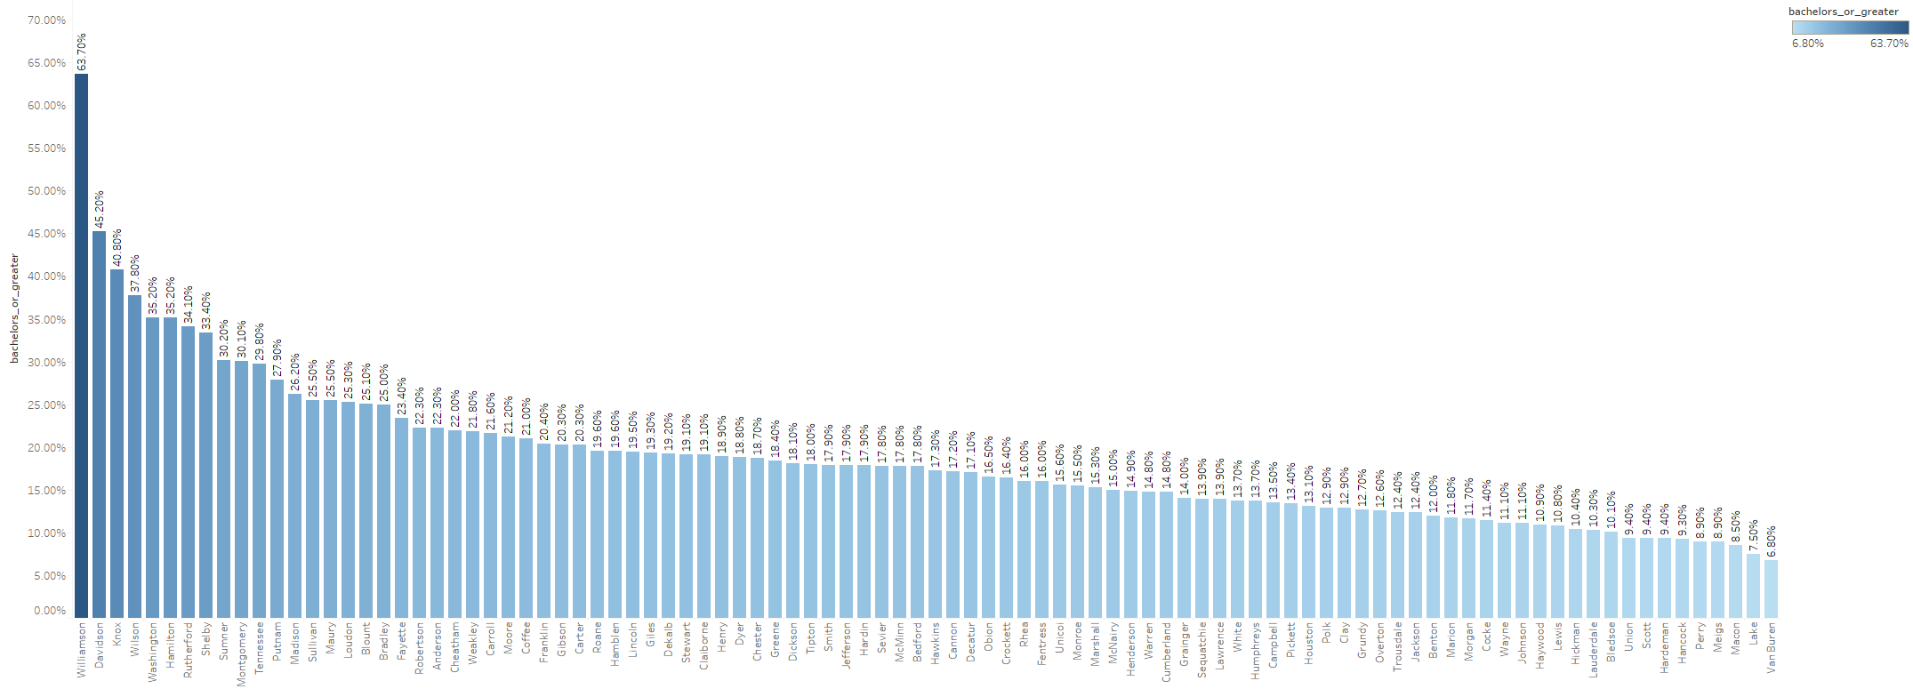
Bachelor Degree Attainment Per County
1st – Williamson – 63.70%
2nd – Davidson – 45%
Personal – Jackson – 12.4%

Slide 8
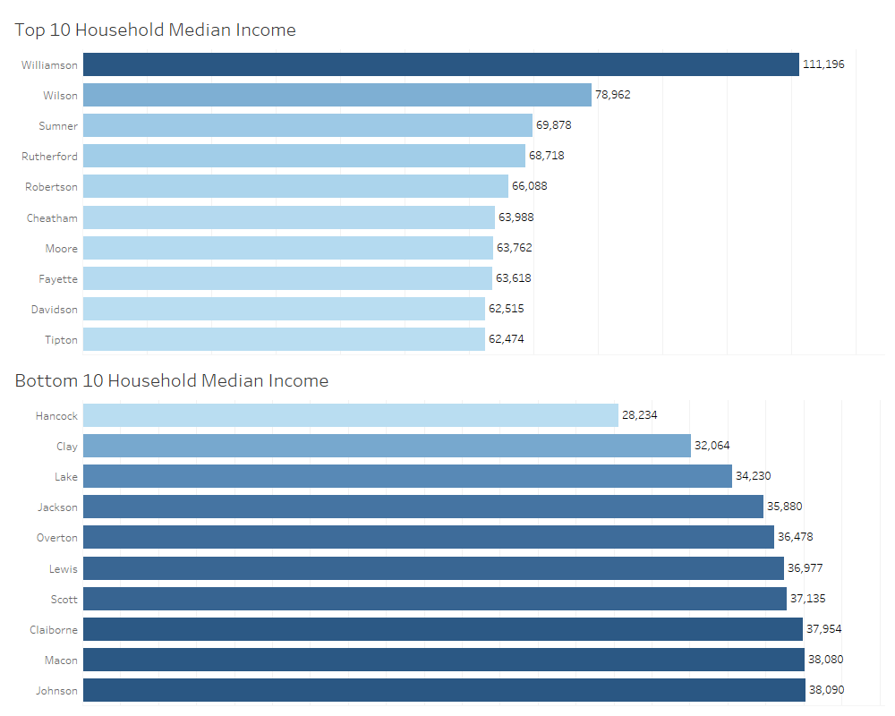
Notes:
(2021 – ACS CENSUS) Table for geographical mobility in past year by education attainment for current residence. (moved from different county within state, moved within same county, moved from diff. state, same house, moved from abroad And totals for all. (per census Margin of Error explanation – numbers are represented with 90% confidence.

Slide 9
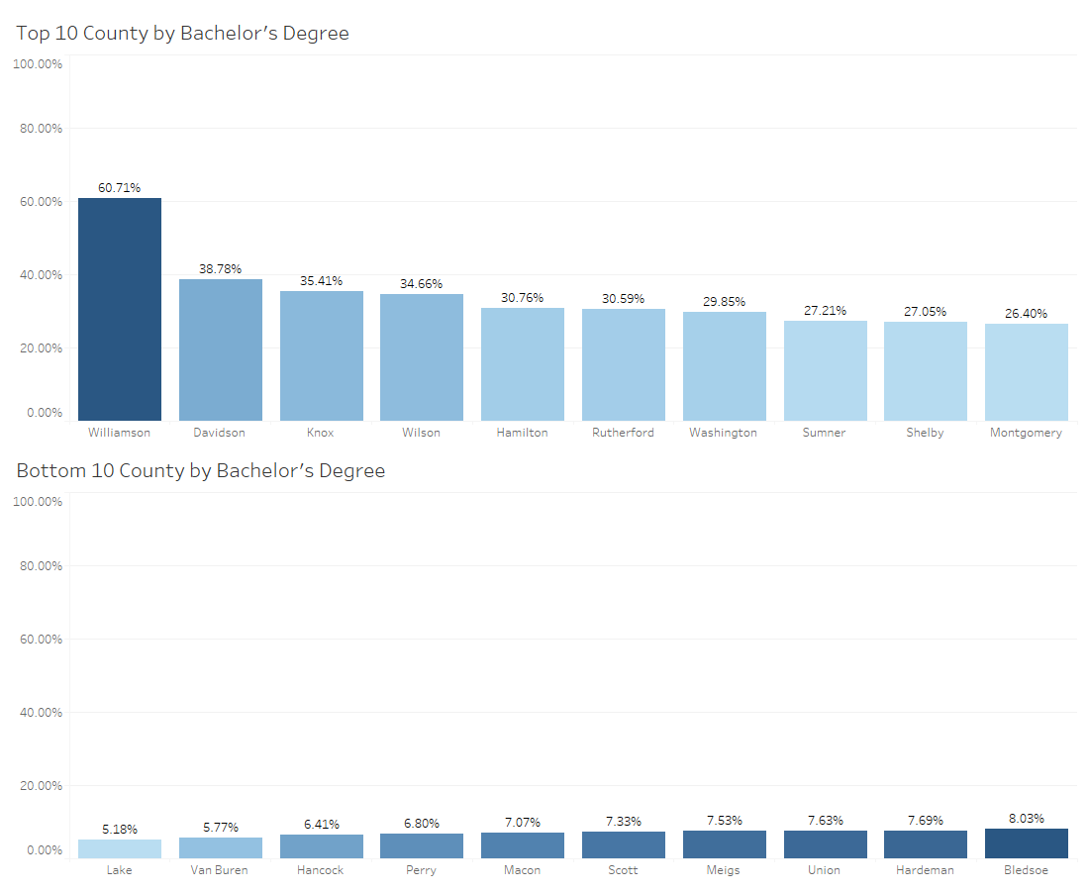
Any disparities?
Notes:
This telling, yet unfortunate chart displays a county’s percentage of adults compared to their county’s total population that have obtained at least a Bachelor’s Degree.

Slide 10
Ready Graduate Economically Disadvantaged
Ready Graduate indicator
ACT 21 (1060 SAT) or over
(min. 30 graduating seniors for inclusion)
Further explanations
Economically Disadvantaged
Reduced / Free Lunch
Financial Assistance / Aid
Poverty Rate variables

Slide 11
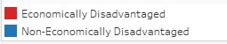
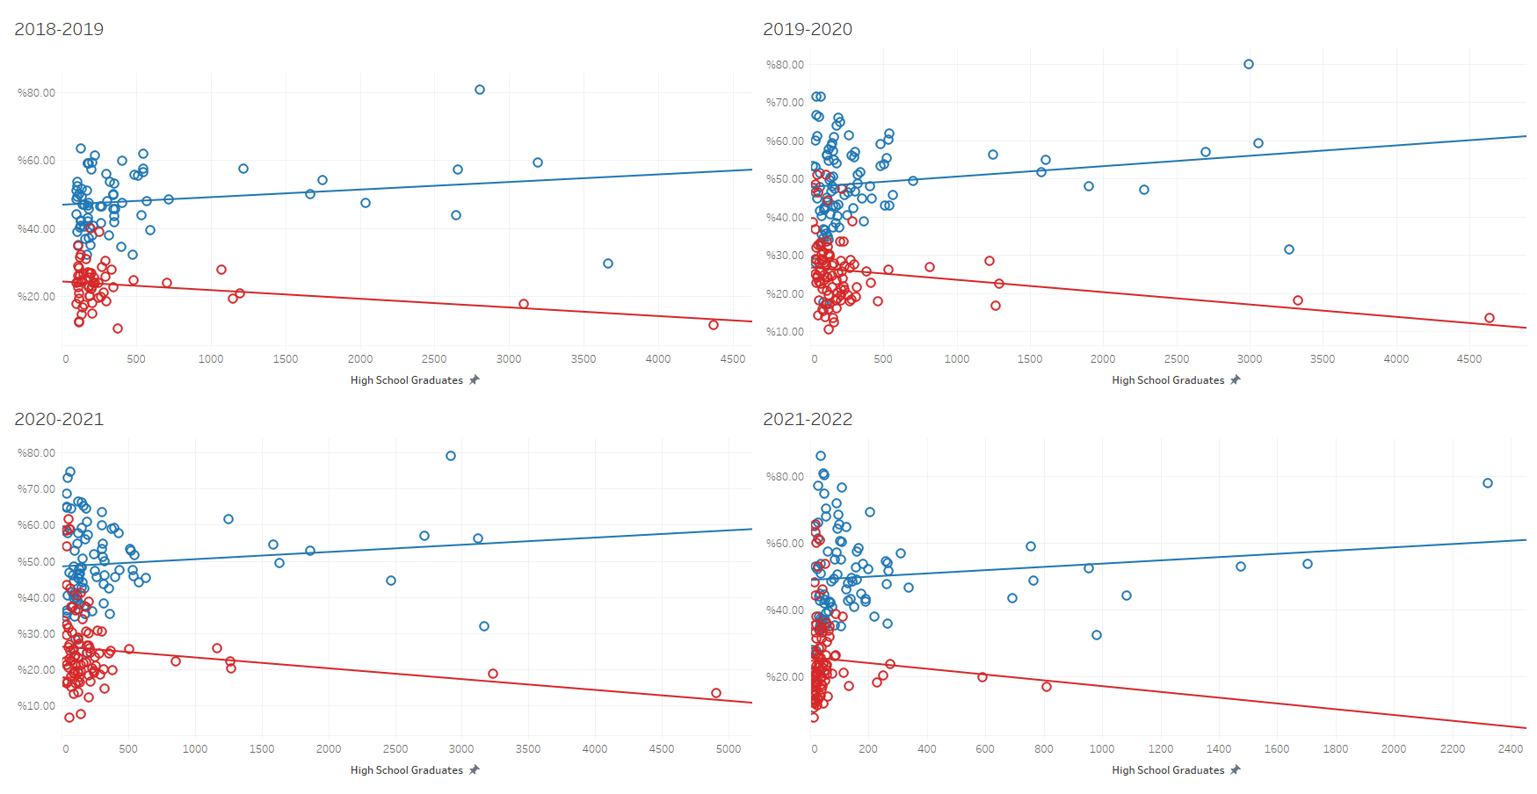
Notes:
I wanted to look further into the trends over the years of counties, and their metrics with ready-grad students for financial disparities to see if there could be any correlation found. Higher concentrated schools tend to skew lines, but still noticeable separation between economically and non-economically disadvantaged.

Slide 12
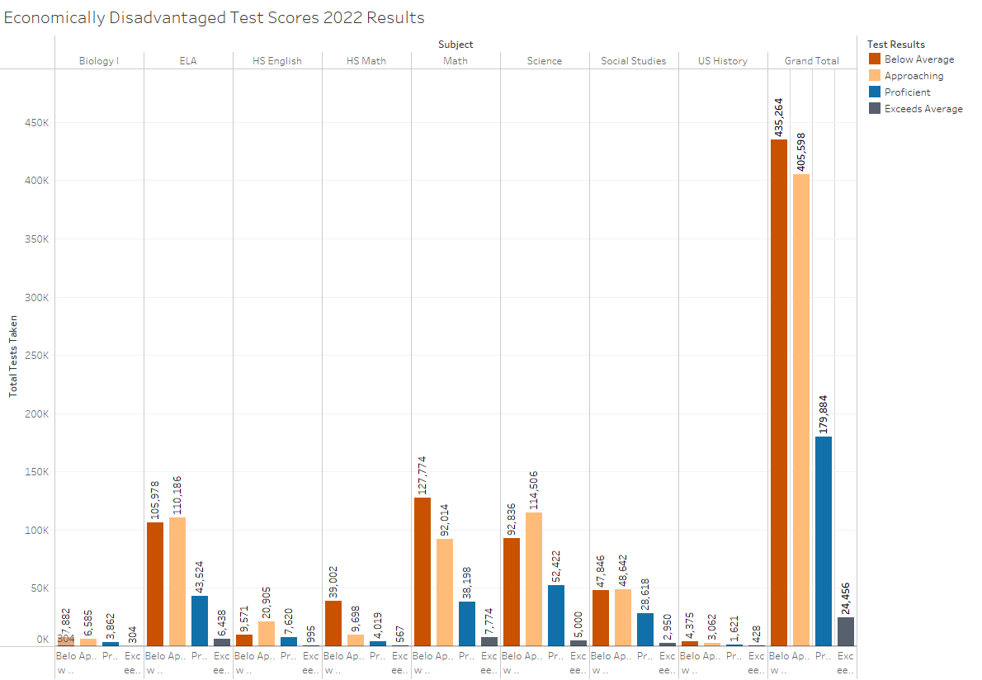
Notes:
Here are all the test scores throughout the state for High School students that are identified as “Economically Disadvantaged”

Slide 13

Summary
Key Takeaways:
Ready Graduate Metric should be revisited and reworked for considering financial dispositions and how to improve the economically disadvantaged metrics to increase eligibility for educational based scholarships.
County income is not solely the driving factor for Bachelor Degree attainment rates.
Notes:
Bachelor Degree attainment rates are trending upwards, but the economically disadvantaged kids based on the TN grad metrics still haven’t changed much at all.

Slide 14
Future inspirations
Expenditures
Regional
Colleges
Returning Adult Education

Slide 15
Data Sources
TN.gov
US Census
Tennessee Higher Education Commission
Notes:
(2021 – ACS CENSUS) Table for geographical mobility in past year by education attainment for current residence. (moved from different county within state, moved within same county, moved from diff. state, same house, moved from abroad And totals for all. (per census Margin of Error explanation – numbers are represented with 90% confidence.

Slide 16

Acknowledgments
My gratitude for Nashville Software School and their Nashville Opportunity Scholarship for students like myself can’t be expressed enough. Also, for believing in me and my potential to empower the community and give back just like they did for me… because otherwise I wouldn’t be here.

Slide 17


